Slide 1

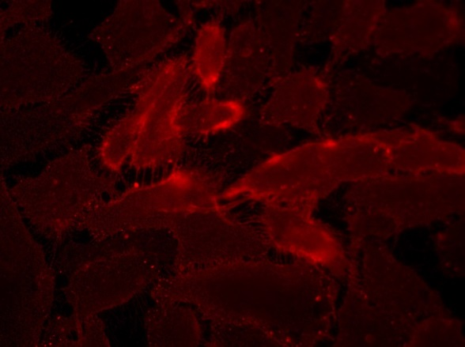
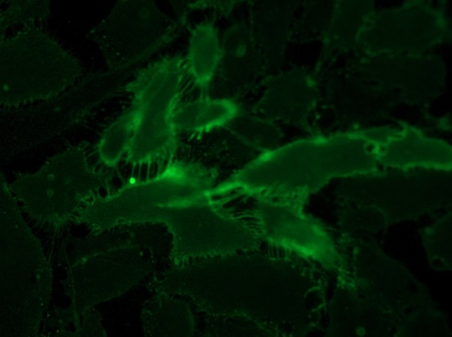
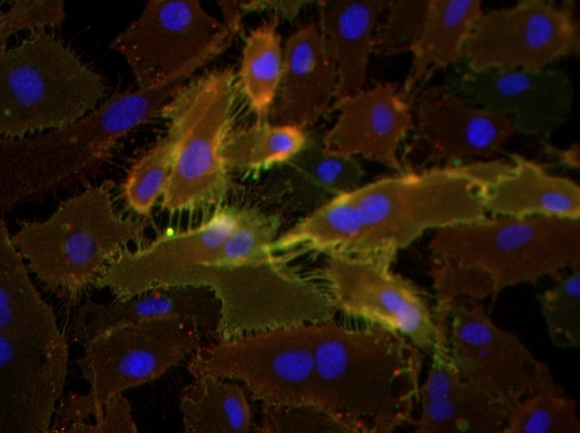
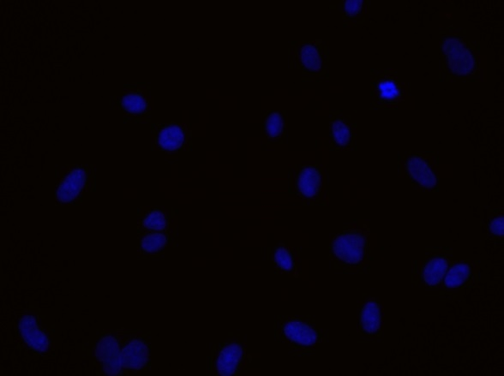
ReliaTech GmbH
Rabbit anti-human NRP-1/mouse anti-human CD31 #WM-59
rabbit anti-human NRP-1 (Cy3)
mouse anti-human CD31 (Alexa Flour 488)
NRP1 / CD31
Control (goat anti-rabbit IgG Cy3 /
Goat anti-mouse IGg ALEXA Flour 488; 1:600)
Immunofluorescence staining of NRP-1 (red) and CD31 (green) in human umbilical vein endothelial cells (HUVEC) with polyclonal rabbit anti-human NRP-1 [Cat# 102-PA23AG] and mouse anti-human CD31 #WM-59 [Cat# 101-M92] (upper panel). Control with goat anti-rabbit Cy3 / goat anti-mouse ALEXA Flour 488 [Dianova] (lower panel).
[IF_HU1407-03; 102-PA23AG/101-M92 (5/2µg/ml), 400X]
http://www.reliatech.de / info@reliatech.de

